Slide 1
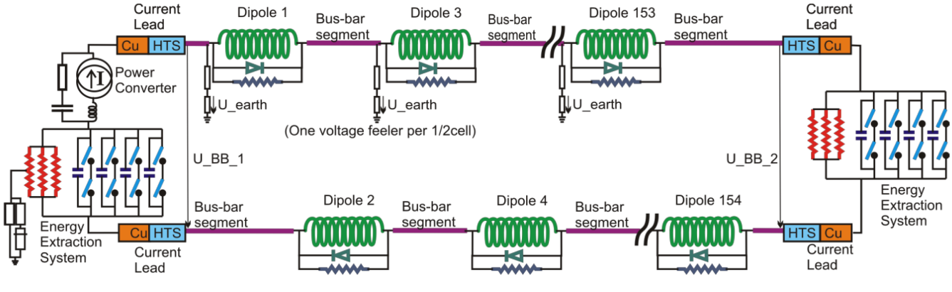
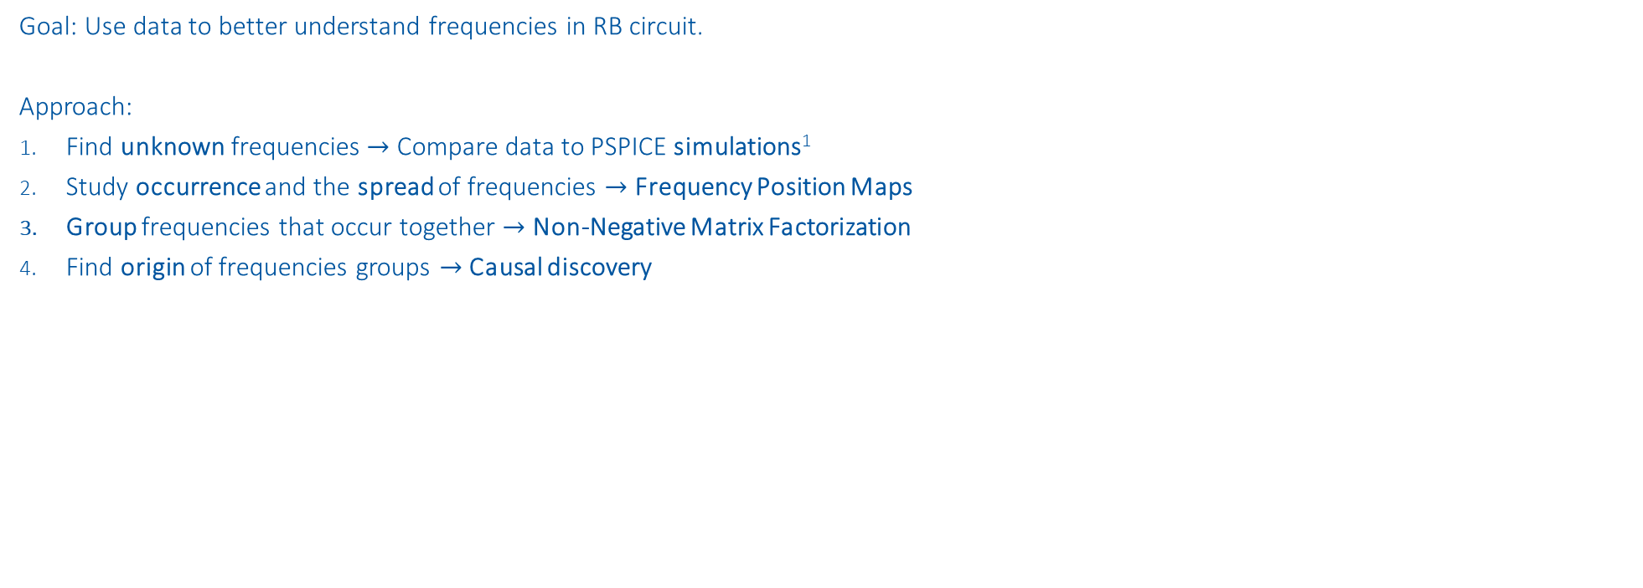
RB Frequency Analysis
Goal: Use data to better understand frequencies in RB circuit.
Approach:
Find unknown frequencies $→$ Compare data to PSPICE simulations¹
Study occurrence and the spread of frequencies $→$ Frequency Position Maps
Group frequencies that occur together $→$ Non-Negative Matrix Factorization
Find origin of frequencies groups $→$ Causal discovery
¹ contributed by MPE-PE STEAM-Team

Slide 2
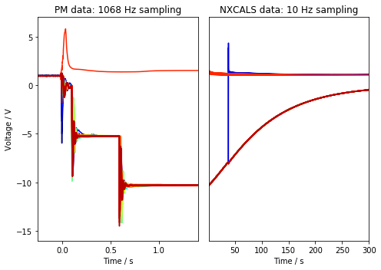
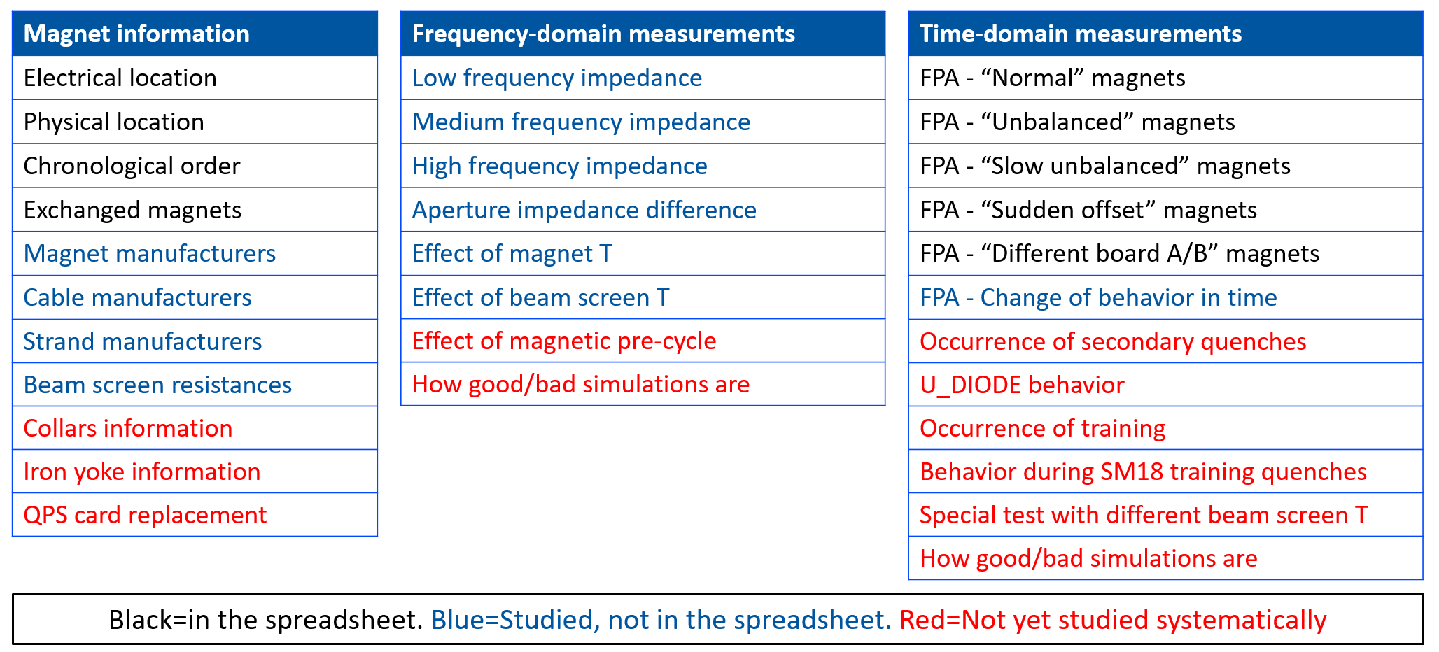
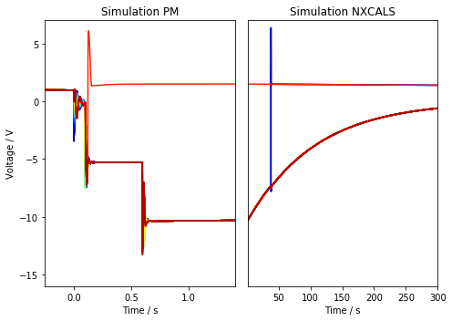
1. Compare data to PSPICE simulations
Conclusion:
Initially analyze U_Diode data
Focus on plateaus after energy extraction
E. Ravaioli and M. Janitschke – Analyzing Fast Power Abort (FPA) tests
MP3 day – 2022/12/01
Event:
RB_RB.A78_1617170255140000000 2021-03-31 07:57:35.120000 Primary Quench at el. Position 141

Slide 3
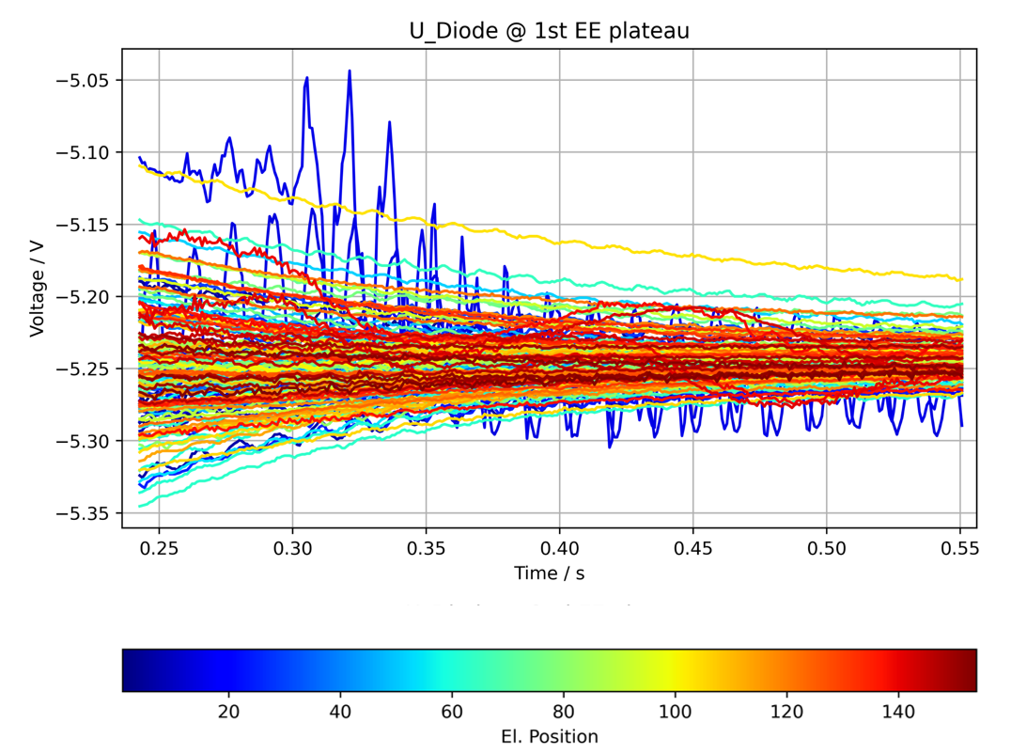
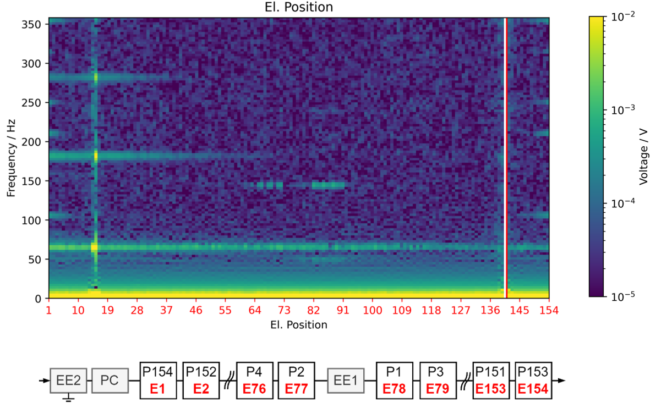
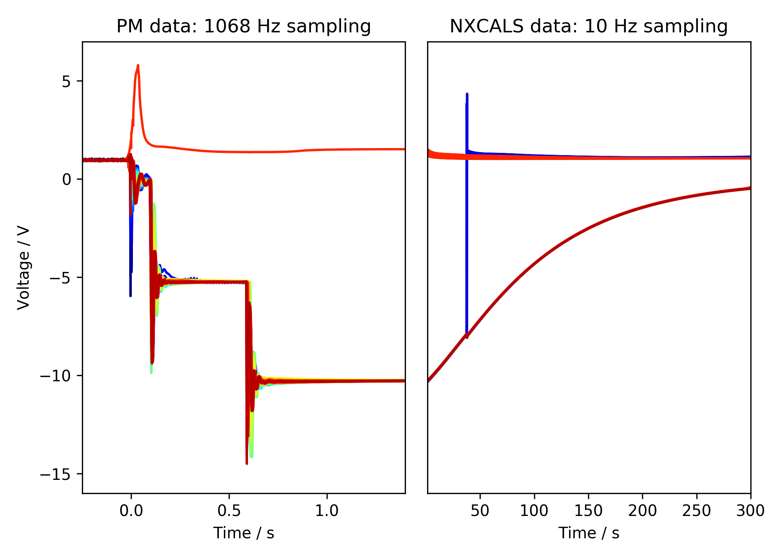
2. Frequency Position Maps
Fast Fourier transform U_Diode plateaus
1st EE
Plateau
fft
2nd EE
Plateau
2nd EE switch off
1st EE switch off
PC Switch off
Event:
RB_RB.A78_1617170255140000000 2021-03-31 07:57:35.120000 Primary Quench at el. Position 141

Slide 4
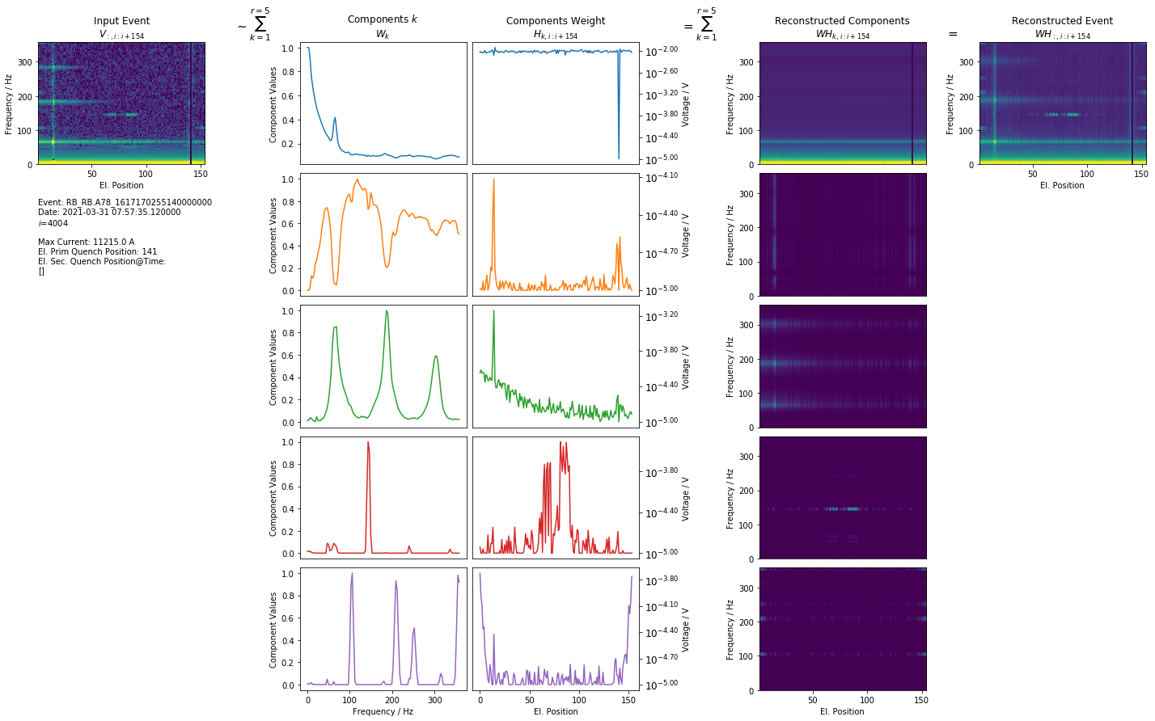
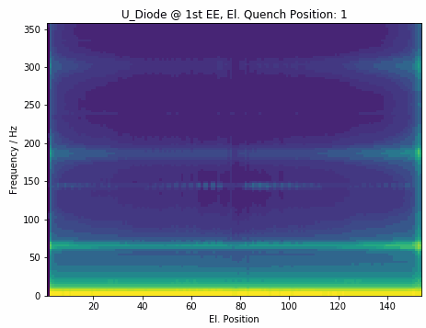
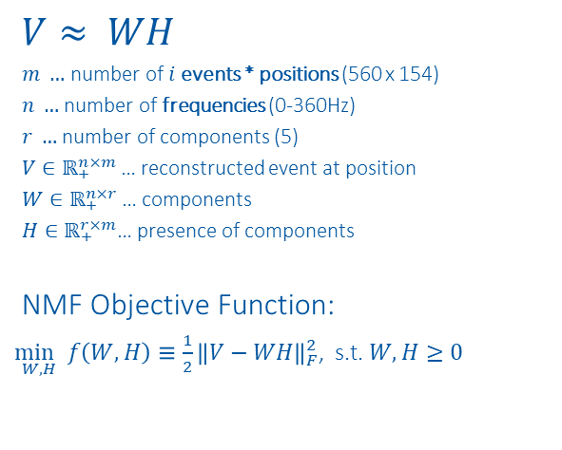
3. Non-Negative Matrix Factorization
$$V≈ WH$$
$m …$ number of $i$events * positions (560 x 154)
$n …$ number of frequencies (0-360Hz)
$r …$ number of components (5)
$V∈ℝ_{+}^{n×m}$… reconstructed event at position
$W∈ℝ_{+}^{n×r}$… components
$H∈ℝ_{+}^{r×m}$… presence of components
NMF Objective Function:
$\underset{W,H}{\min{ }}f\left(W, H\right)≡\frac{1}{2}{\left\|V−WH\right\|}_{F}^{2}$, s.t. $W, H≥0$
Event:
RB_RB.A78_1617170255140000000 2021-03-31 07:57:35.120000 Primary Quench at el. Position 141

Slide 5
Component interpretation

Slide 6
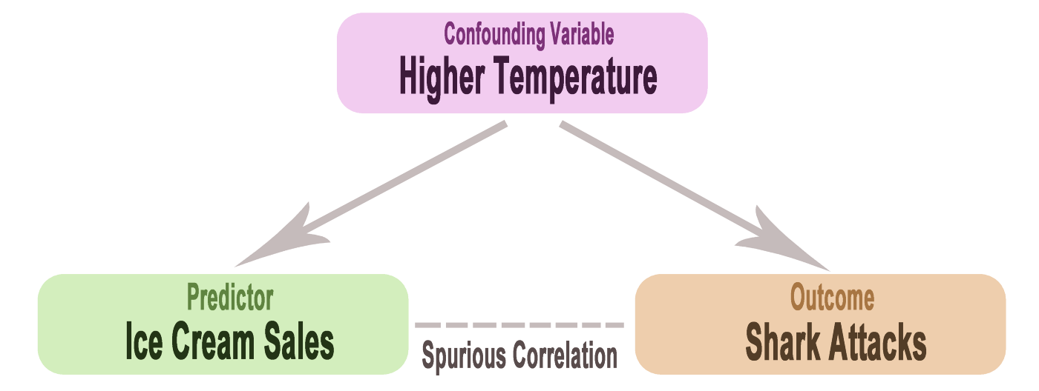
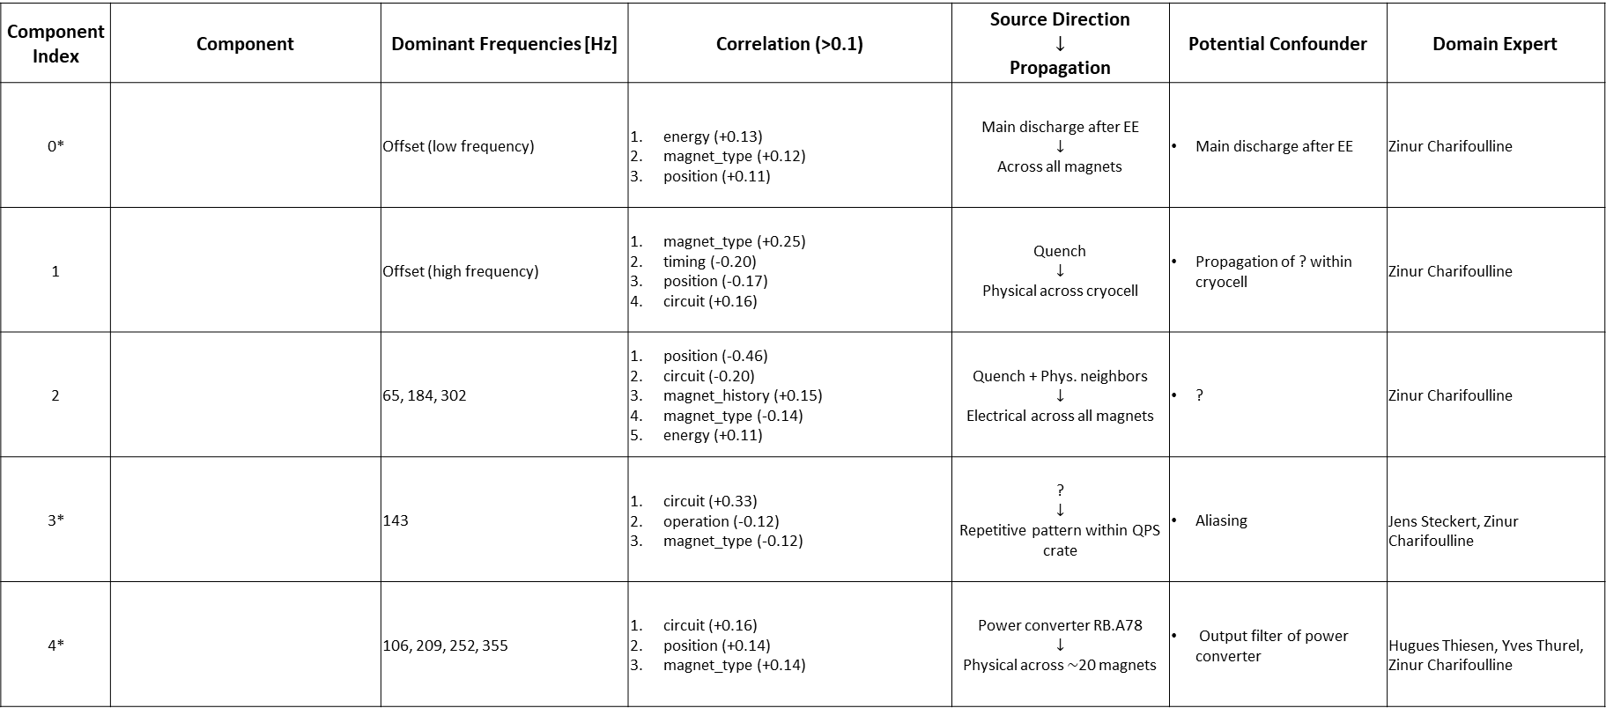
4. Causal Discovery
Component Index | Component | Dominant Frequencies [Hz] | Correlation (>0.1) | Source Direction $$↓$$ Propagation | Potential Confounder | Domain Expert
0* |  | Offset (low frequency) | energy (+0.13) magnet_type (+0.12) position (+0.11) | Main discharge after EE $$↓$$ Across all magnets | Main discharge after EE | Zinur Charifoulline
1 |  | Offset (high frequency) | magnet_type (+0.25) timing (-0.20) position (-0.17) circuit (+0.16) | Quench $$↓$$ Physical across cryocell | Propagation of ? within cryocell | Zinur Charifoulline
2 |  | 65, 184, 302 | position (-0.46) circuit (-0.20) magnet_history (+0.15) magnet_type (-0.14) energy (+0.11) | Quench + Phys. neighbors $$↓$$ Electrical across all magnets | ? | Zinur Charifoulline
3* |  | 143 | circuit (+0.33) operation (-0.12) magnet_type (-0.12) | ? $$↓$$ Repetitive pattern within QPS crate | Aliasing | Jens Steckert, Zinur Charifoulline
4* |  | 106, 209, 252, 355 | circuit (+0.16) position (+0.14) magnet_type (+0.14) | Power converter RB.A78 $$↓$$ Physical across $\sim$20 magnets | Output filter of power converter | Hugues Thiesen, Yves Thurel, Zinur Charifoulline
*Component also occurs in snapshot events
Event:
RB_RB.A78_1617170255140000000 2021-03-31 07:57:35.120000 Primary Quench at el. Position 141

Slide 7
Approach
Frequency range: 0Hz – 360Hz
Voltage range: 1e-3V – 1V

Slide 8
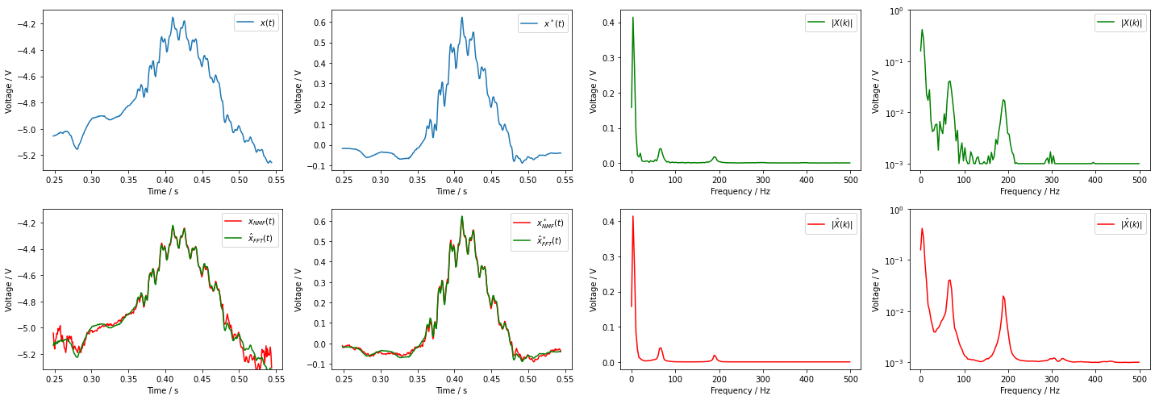
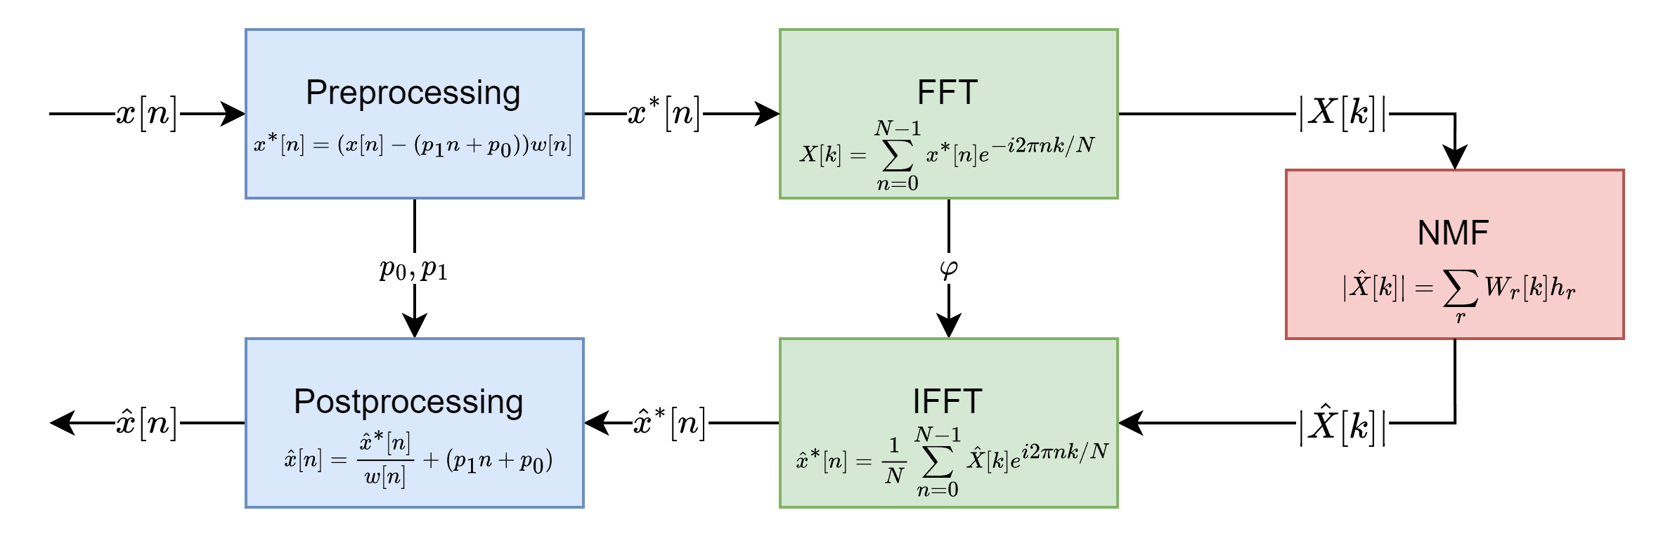
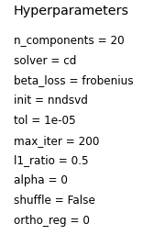
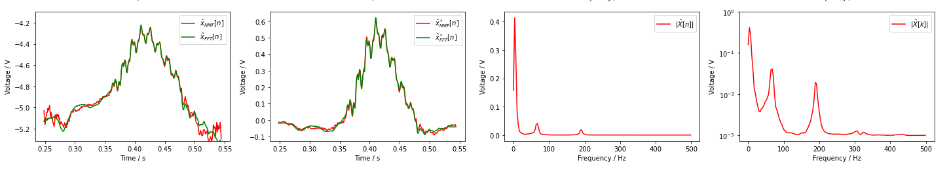

Slide 9
Anomaly detection
Frequency range: 0Hz – 500Hz
Voltage range: 1e-3V – 1V

Slide 10
